Slide 1
Reality of News
Predict by Using LSTM

Slide 2
Data Information
A group of News include website, text, title.
Labeled as fake or real. 1672 fake News and 211 real News.
Download from Kaggle
Collected for Analyzing the reality of News.

Slide 3
Research QUESTION
Detect a News is fake or new
Useful for people who read news everyday. 75% of American adults who viewed a fake news headline viewed the story as accurate and Fake news stories are widely shared on social media.
Notes:
The intention and purpose behind fake news is important. In some cases, what appears to be fake news may in fact be news satire, which uses exaggeration and introduces non-factual elements that are intended to amuse or make a point, rather than to deceive.

Slide 4
Tools
Pandas : Preprocessing
GloVe: Preprocessing
Keras: Prediction
Tensorflow: Prediction

Slide 5
Data munging
88% of data is fake
We use the method of Oversampling to figure out the problem of data balance
Import SMOTE
After sampling, the number of fake News and real News are same. There are 1340 real news and 1340 fake news.

Slide 6
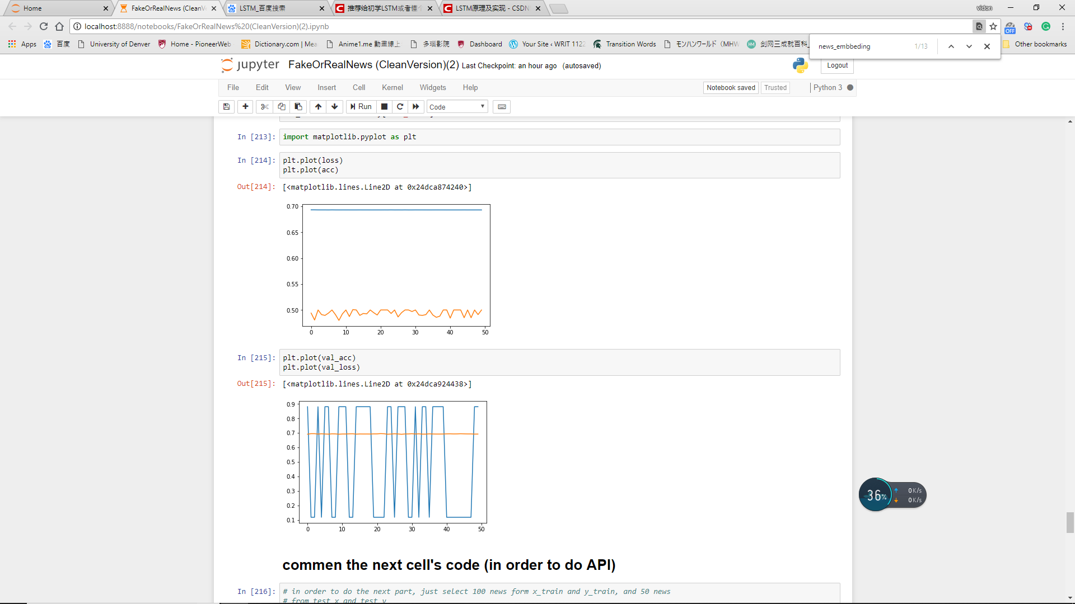
Main visualization

Slide 7
Modeling activity
Independent variables: 1506 vectors in matrix
Model: LSTM
Motivate: Predict the article by order

Slide 8
Current finding
'https://www.bbc.com/news/world-middle-east-45128367’
By inputting a new link of News, we got a result of ‘real’

